Slide 1


Presentation on
A STAR PATH
FINDING
Artificial Intelligence and Data Science
Department of AI&DS

Slide 2

A* ALGORITHM
The A* (A-star) algorithm is a widely used pathfinding algorithm in AI that efficiently finds the shortest path between two points by combining the actual cost of a path with a heuristic estimate of the remaining cost to the goal.

Slide 3

GOAL
The goal of this project is to implement the A algorithm* for efficient pathfinding by:
Finding the shortest and optimal path to the goal.
Analyzing its performance in various environments.
Comparing it with other pathfinding techniques.
Exploring optimizations to enhance efficiency and adaptability.

Slide 4

PROBLEM STATEMENT
Finding the shortest and most efficient path is crucial in navigation, robotics, and gaming.
The A algorithm* helps solve this by using a heuristic-based search method.
This project implements A to test, analyze, and optimize its performance.*

Slide 5
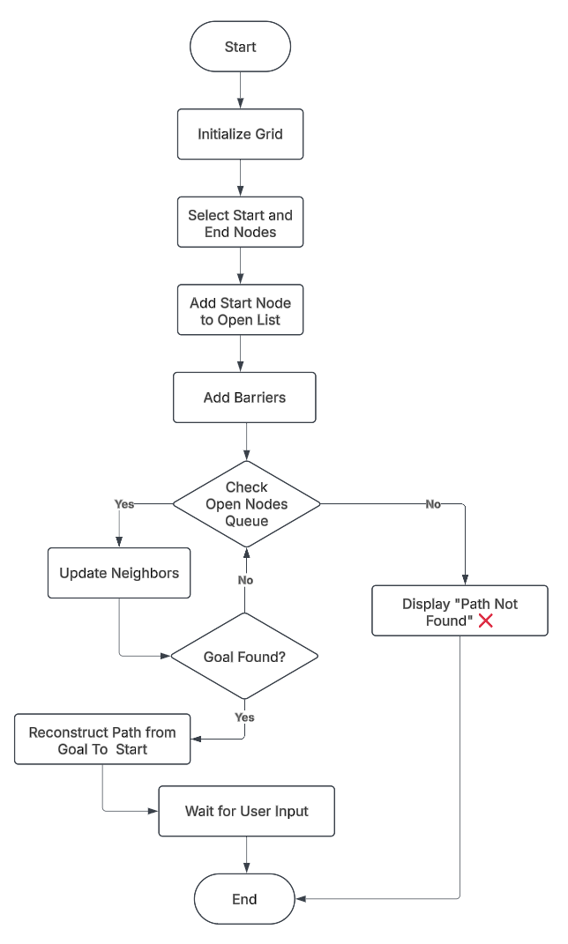
FLOW CHART

Slide 6

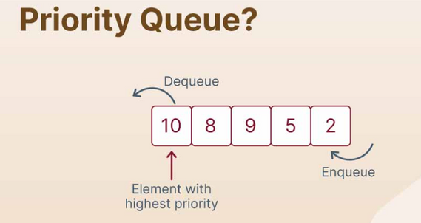

LIBRARIES USED
Pygame: Visualization and grid rendering
Queue (PriorityQueue): Manages open nodes efficiently.
Math: Used for heuristic calculations.

Slide 7

ALGORITHM
Initialize the grid and define start/end points.
Use f(n) = g(n) + h(n) to prioritize paths.
Expand nodes in order of the lowest f(n) value.
Update neighbors and check for goal completion.
Reconstruct path once the goal is reached.
If no path exists, display “Path Not Found” message

Slide 8

Step 1: Run the Python script.
Step 2: A window with a grid appears.
Step 3: Left-click to select the start node.
Step 4: Left-click again to select the end node.
Step 5: Left-click to create barriers (obstacles).
Step 6: Press SPACE to start the A algorithm*.
Step 7: The algorithm finds and visualizes the shortest path.
Step 8: If no path is found, a "Path Not Found" message appears.
Step 9: Press C to clear the grid and restart.
Step 10: Close the window to exit.
STEP BY STEP EXECUTION GUIDE

Slide 9
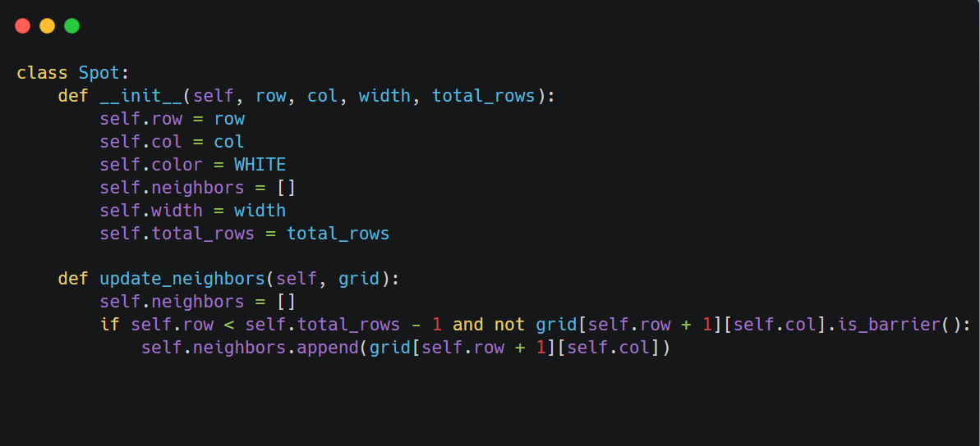
CODE
Node Class:
Handles position, neighbors, and states.

Slide 10
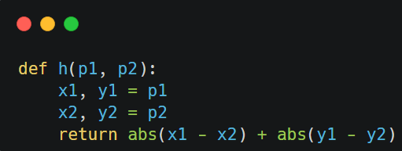
CODE
2. Heuristic Function
Uses Manhattan Distance for path estimation.

Slide 11
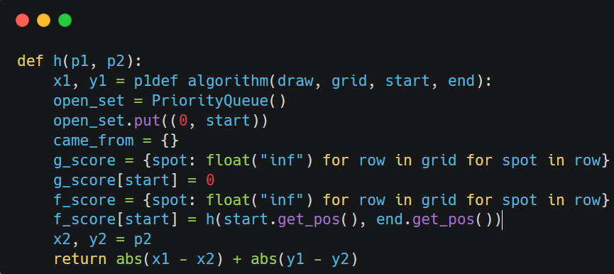
CODE
3. Algorithm Execution
Implements A* using PriorityQueue.

Slide 12
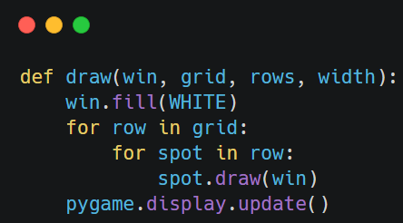
CODE
4. Visualization
Uses Pygame to display the
pathfinding process.

Slide 13


OUTPUTS
(a) Pre-condition
(b) Output
Fig1. Path without barriers

Slide 14

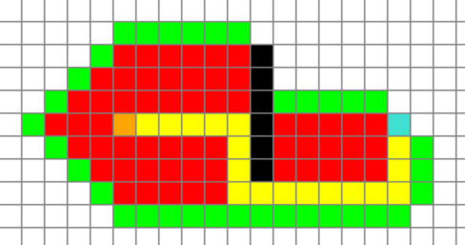
OUTPUTS
(a) Pre-condition
(b) Output
Fig2. Path with barriers

Slide 15
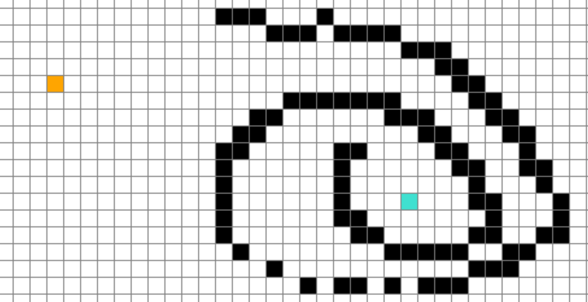

OUTPUTS
(a) Pre-condition
(b) Output
Fig3. Path with complex barriers

Slide 16
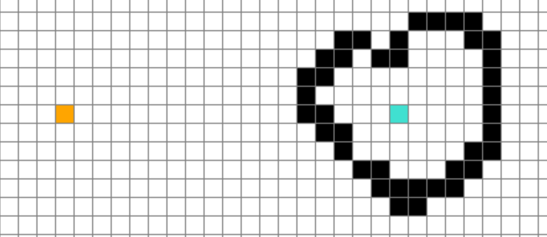


OUTPUTS
(a) Pre-condition
(b) Output
Fig4. Path with no solution

Slide 17
THANK YOU!
FOR YOUR ATTENTION
KANAK TAGDE - 042
KSHITIJ WASULE - 045
MUKUL AWARE - 046
PRAJWAL GHUTKE - 051
RITESH BURANGE - 054
RUGVED PISE - 056

